Slide 1
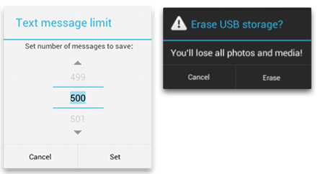
Dialogs
Is small window that prompts the user to make a decision or enter additional information's.
Dialog boxes in Android are partially transparent, floating Activities or Fragments that partially obscure the user interface
A dialog doesn’t fill the screen and is normally used for modal events that require users to take an action before they can procced.

Slide 2
Why Dialogs
Dialogs can be used in different ways
Can be used to help users answers some questions
To make Selection
Display warning or error messages
Confirm Actions

Slide 3
Types of Dialog
The Dialog class is the base class for dialogs but we have to instantiate the subclasses of Dialog rather than using directly.
In android the most commonly used types of dialogs are
Alert Dialog
Progress Dialog (Progress Bar)
Date and Time Picker
Custom Dialog
Alert Dialog: shows alert messages and gives the answer in the form of yes or no. According to our response the next step is processed.

Slide 4
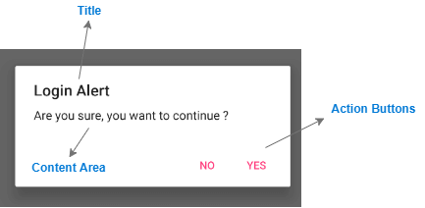
Cont’d[Alert Dialog]
Android Alert Dialog is built with three fields:
Title
Message(Content) Area
Action Button
Title: This is optional and should be used only when the content area is occupied by a detailed message , a list or custom layout.
We use setTitle() method for displaying Alet Dialog box Title, setIcon() is used to set the icon before the title.
Message(Content) Area: this can display a message, a list, or other custom layout.
We use setMessage() method for displaying the message
Action Button: There should be no more than three action buttons in a dialog.

Slide 5
Cont’d
Positive: used to accept and continue with the action(the “Ok” or “Yes” action)
Negative: used to cancel the action(“No” action)
Neutral: used when the user may not want to proceed with the action, but doesn't necessarily want to cancel (“Remind Me Later” action)
We can add a list in Alert Dialog
A traditional single-choice list
A single-choice list (radio buttons)
A multiple-choice list (checkboxes
setItems() method can be used to add our list items.
setSingleChoiceItems() used to create a list of Radio Buttons
setMultipleChoiceItems() used to create a list of Check Boxes.

Slide 6
Example
Try to develop this dialog when a button is pressed.
Are you want to exit?
Yes No

Slide 7
Cont’d
AlertDialog.Builder builder = new AlertDialog.Builder(MainActivity.this); builder.setTitle("Login Alert") .setMessage("Are you sure, you want to exit ?") .setCancelable(false) .setPositiveButton("Yes", new DialogInterface.OnClickListener() { @Override public void onClick(DialogInterface dialog, int which) { MainActivity.this.finish(); } }) .setNegativeButton("No", new DialogInterface.OnClickListener() { @Override public void onClick(DialogInterface dialog, int which) { dialog.cancel();
} }); //Creating dialog box AlertDialog dialog = builder.create(); dialog.show(); } });
Java Code

Slide 8
Progress Dialog: is used to display the status of work being done like analyzing status of work or downloading a file.
By default the Progress Bar will be displayed as a Spinning wheel, if we want to display it in a horizontal bar we have to change the style property to horizontal like
style="?android:attr/progressBarStyleHorizontal".
Progress bar supports two type of modes to show the progress.
Determinate
Indeterminate
Determinate: progress mode is used in progress bar when we want to show the quantity of progress has occurred. For example, the percentage of file downloaded or percent remaining of an audio file that is playing.

Slide 9
Cont’d
To use Determinate progress, we need to set the style of the progress bar to progressBarStyleHorizontal and set the amount of progress using android:progress attribute.
Indeterminate: progress mode is used in progress bar when we don’t know how long an operation will take or how much work has done.
In indeterminate mode the actual progress will not be shown, only the cyclic animation will be shown to indicate that some progress is happing.
Progress Bar is different from Progress Dialog
Progress Bar is a View, which can be used in the layout to show some progress while the user may still interact with other parts
Progress Dialog is a Dialog with builtin Progress Bar (depreciated in Api 26). It is used when we want to prevent the user from interacting with the application. The Dialog freezes the user from doing anything until it is dismissed

Slide 10
Indeterminate Mode
Using Progress Dialog
ProgressDialog loading;
loading= ProgressDialog(context,title,message,indeteminate(boolean), cancelable);
Using Progress Bar
<ProgressBar
android:id="@+id/simpleProgressBar"
android:layout_width="wrap_content"
android:layout_height="wrap_content"
android:visibility="invisible"
android:layout_centerHorizontal="true"/>
In our Activity
final ProgressBar simpleProgressBar = (ProgressBar) findViewById(R.id.simpleProgressBar);
Button startButton = (Button) findViewById(R.id.startButton);
// perform click event on button
startButton.setOnClickListener(new View.OnClickListener() {
@Override
public void onClick(View v) {
// visible the progress bar
simpleProgressBar.setVisibility(View.VISIBLE);
}
});

Slide 11
Determinate Mode
progressDialog = new ProgressDialog(MainActivity.this);
progressDialog.setMax(100); // Progress Dialog Max Value
progressDialog.setMessage("Loading..."); // Setting Message
progressDialog.setTitle("ProgressDialog"); // Setting Title
progressDialog.setProgressStyle(ProgressDialog.STYLE_HORIZONTAL); // Progress Dialog Style Horizontal
progressDialog.show(); // Display Progress Dialog
progressDialog.setCancelable(false);
new Thread(new Runnable() {
@Override
public void run() {
try {
while (progressDialog.getProgress() <= progressDialog.getMax()) {
Thread.sleep(200);
progressDialog.incrementProgressBy(2);
if (progressDialog.getProgress() == progressDialog.getMax()) {
progressDialog.dismiss();
}
}
} catch (Exception e) {
e.printStackTrace();
}
}
}).start();
}
});
}

Slide 12
Date and Timer Picker Dialog: A dialog that is used to select date and time.
Custom Dialog: To create a Custom Dialog we need to create a Custom Layout for the Dialog window with Layout and Widget elements.
We set the custom layout as the dialog content view
Context mContext = getApplicationContext();
Dialog dialog = new Dialog(mContext);
dialog.setContentView(R.layout.custom_dialog);
dialog.setTitle("Custom Dialog");
TextView text = (TextView) dialog.findViewById(R.id.text);
text.setText("Hello, this is a custom dialog!");
ImageView image = (ImageView) dialog.findViewById(R.id.image);
image.setImageResource(R.drawable.android);

Slide 13
Fragment
Assume you want your app to behave differently depending on whether it’s running on a phone or a tablet? In such cases you need Fragments.
The aim of Fragment is to create modular code in our Application.
The code can be reused by different activities.
Fragments have their own lifecycle and layouts or UI components
A Fragment is a class that contains a portion of an application’s user interface, which can be added as part of an app UI.
Fragments also have their logic and can thus, accept and handle different events.
E.g. The standard date picker is a Fragment—an instance of Dialog Fragment, a subclass of Fragment—that enables the user to input a date. The standard date picker shows a dialog window floating on top of the Activity window.

Slide 14
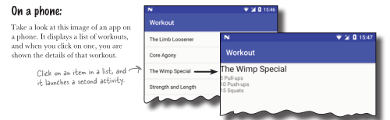
Example

Slide 15
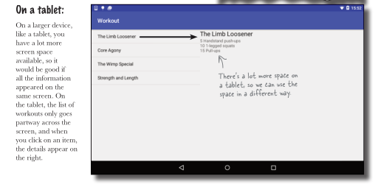
Cont’d[Example]

Slide 16
Activity vs Fragment
Activity | Fragment
Activity is an application component that gives a user interface where the user can interact. | The fragment is only part of an activity, it basically contributes its UI to that activity.
Activity is not dependent on fragment | Fragment is dependent on activity. It can’t exist independently.
we need to mention all activity it in the manifest.xml file | Fragment is not required to mention in the manifest file
Activity is not light weight. | The fragment is the light weight.
We can’t create multi-screen UI without using fragment in an activity. | After using multiple fragments in a single activity, we can create a multi-screen UI.

Slide 17
Features of Fragments
Before fragments we can show a single Activity on the screen at once. But with the help of fragments we can divide the screen and controls different parts separately.
Reuse a Fragment. We can write the Fragment code once, and reuse the Fragment in more than one Activity without having to repeat code.
Add or remove a Fragment dynamically. Add, replace, or remove a Fragment from An activity as needed.
Integrate a mini-UI within the Activity. Integrate a Fragment with an Activity UI or overlay the UI, so that the user can interact with the Fragment UI without leaving the Activity.
Retain data instances after a configuration change. Since a Fragment has its own lifecycle, it can retain an instance of its data after a configuration change (such as changing the device orientation).
Represent sections of a layout for different screen sizes. Encapsulating an interactive UI within a Fragment makes it easier to display the interactive UI on different screen sizes.

Slide 18
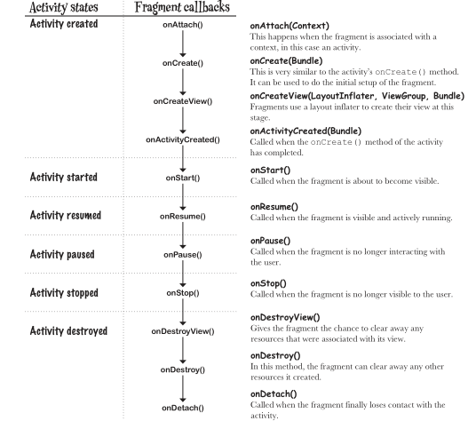
Fragment Life Cycle

Slide 19
Cont’d
N.B. A Fragment lifecycle is very similar to an Activity life cycle’s., , but it has a few extra steps. This is because it needs to interact with the lifecycle of the activity that contains it.
As with an Activity, you can save the variable assignments in a Fragment.
onCreateView(): The onCreateView() method returns a View object that represents the fragment’s user interface. It gets called when Android is ready to instantiate the user interface, and it takes three parameters:
Layout inflator: used for inflating the fragment layout. Inflating the layout turns your XML views into Java Objects.
View Group: This is the View Group in the activity’s layout that will contain the fragment.
Bundle: . This is used if you’ve previously saved the fragment’s state, and want to reinstate it.

Slide 20
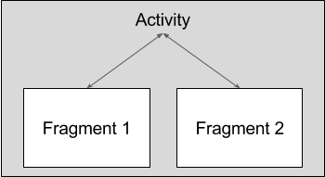
Use Activity context on Fragment
The Activity context is used by a fragment to get a reference to its hosting Activity.
getActivity() is used to achieve this task
View listView = getActivity().findViewById(R.id.list);
N.B. getActivity() when the Fragment is not attached to an Activity, getActivity() returns null.
Use Fragment Methods in the host Activity
your Activity can call methods in the Fragment by acquiring a reference to the Fragment from FragmentManager or Support Fragment Manager, using findFragmentById()
ExampleFragment fragment = (ExampleFragment) getFragmentManager().findFragmentById(R.id.example_fragment);
Fragment to Fragment communication is handled through Activity

Slide 21
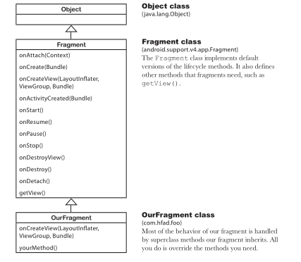
Fragment inherit lifecycle methods
The fragment class doesn’t extend the Activity class.
Some methods that are available to activities aren’t available to fragments.
Fragment class doesn’t implement the Context
Class. So, unlike an activity, a fragment isn’t a type
of context and therefore doesn’t have direct access
to global information about the application environment.
Instead, fragments must access this information using the
context of other objects such as its parent activity.

Slide 22
Exercise
Create WorkoutDetail Fragment
Create WorkoutList Fragment
Coordinate the fragments to display the correct workout
First we need to create Main Activity and Detail Activity
Main Activity is used for WorkoutList Fragement
Detail Activity is used for WorkoutDetail Fragment.
We start by working on the fragment for DetailActivity first, and adding a button to MainActivity will give us an easy way of navigating from
MainActivity to DetailActivity.
In your activity_main add button, in the activity code start Intent to shift into Detail Activity

Slide 23
Workout Detail Fragment
In Your Package name, New...→Fragment→Fragment (Blank).
<LinearLayout
<TextView
android:layout_width="wrap_content"
android:layout_height="wrap_content"
android:textAppearance="?android:attr/textAppearanceLarge"
android:text="@string/workout_title"
android:id="@+id/textTitle" />
<TextView
android:layout_width="wrap_content"
android:layout_height="wrap_content"
android:text="@string/workout_description"
android:id="@+id/textDescription" />

Slide 24
DetailActivity Layout
layout file requires a single view or view group as its root element. If your activity only contains a fragment, the fragment itself can be the root element.
<fragment
xmlns:android="http://schemas.android.com/apk/res/android"
android:name="com.hfad.workout.WorkoutDetailFragment“
android:id="@+id/detail_frag"
android:layout_width="match_parent"
android:layout_height="match_parent" />

Slide 25
Workout class (refer page no. 360)
public class WorkoutDetailFragment extends Fragment {
private long workoutId;
@Override
public View onCreateView(LayoutInflater inflater, ViewGroup container,
Bundle savedInstanceState) {
return inflater.inflate(R.layout.fragment_workout_detail, container, false);
}
@Override
public void onStart() {
super.onStart();
View view = getView();
if (view != null) {
TextView title = (TextView) view.findViewById(R.id.textTitle);
Workout workout = Workout.workouts[(int) workoutId];
title.setText(workout.getName());
TextView description = (TextView) view.findViewById(R.id.textDescription);
description.setText(workout.getDescription());
}
}
public void setWorkout(long id) {
this.workoutId = id;
}
}
Fragments don’t include
a findViewById() method, for instance.
To get a reference to a fragment’s views,
we first have to get a reference to the
fragment’s root view using the getView()
method, and use that to find its child views.

Slide 26
WorkList Fragment
A list fragment is a fragment that contains only a list
A list fragment is a type of fragment that specializes in working with a list view. It has a default layout that contains the list view.
Advantage of List Fragment
You don’t to create your own Layout
There is no XML layout needed. List Fragment define there own layout programmatically.
getListView() method is used to access the list view in your fragment code
You don’t have to implement your own event Listener
List Fragment class automatically implements an event listener that listens for when items in the list view are clicked. We just need to implement onListItemClick() method.

Slide 27
Add data to ListView Fragment
We want to supply the list view in WorkoutListFragment with an array of workout names
ArrayAdapter can be used to bind our workout names(array) in list view.
Unlike an Activity we cant use this to pass the current context to the array adapter. Why?
The solution is use another object getContext() method to get a reference to the current context.
If the adapter is created on the fragment’s onCreateView() method, the getContext() method of the onCreateView() LayoutInflator parameter can be used to get the context instead.
The last step is to set adapter in the listview. We use setListAdapter() method.

Slide 28
WorkListFragment
public class WorkoutListFragment extends ListFragment {
@Override
public View onCreateView(LayoutInflater inflater, ViewGroup container,
Bundle savedInstanceState) {
String[] names = new String[Workout.workouts.length];
for (int i = 0; i < names.length; i++) {
names[i] = Workout.workouts[i].getName();
}
ArrayAdapter<String> adapter = new ArrayAdapter<>(
inflater.getContext(), android.R.layout.simple_list_item_1,
names);
setListAdapter(adapter);
return super.onCreateView(inflater, container, savedInstanceState);
}
}

Slide 29
Main Activity Layout
<fragment
xmlns:android="http://schemas.android.com/apk/res/android"
android:name="com.hfad.workout.WorkoutListFragment“
android:id="@+id/detail_frag"
android:layout_width="match_parent"
android:layout_height="match_parent" />

Slide 30
Connect the list to detail
3 steps
Add code to WorkoutListFragment that waits for a workout to be clicked.
When that code runs, call some code in MainActivity.java that will start DetailActivity, passing it the Id of the Workout
Get DetailActivity to pass the ID to WorkoutDetailFragment so that the fragment can display details of the correct workout.
By defining Interface in our work list fragment we can communicate the work list with main activity with little effort as well we can reuse code.

Slide 31
ListView Fragment
Define the Listener interface
static interface Listener {
void itemClicked(long id);
};
Register the listener: We need to save a reference to the activity WorkoutListFragment.
private Listener listener;
public void onAttach(Context context) {
super.onAttach(context);
this.listener = (Listener)context;
}

Slide 32
Cont’d
Respond to clicks: When an item in WorkoutListFragment gets clicked, we want to call the listener’s itemClicked() method.
public void onListItemClick(ListView listView, View itemView, int position, long id) {
if (listener != null) {
listener.itemClicked(id);
}
}

Slide 33
Main Activity
Main Activity needs to implement the interface
public class MainActivity extends AppCompatActivity
implements WorkoutListFragment.Listener {
@Override
public void itemClicked(long id) {
Intent intent = new Intent(this, DetailActivity.class);
intent.putExtra(“id”, (int)id);
startActivity(intent);
}

